Slide 1
SAFEGUARDING AGAINST PHISHING ATTACK BY BHARTI INTENSHIP : CODE ALPHA

Slide 2
AGENDA
Recognizing phishing emails
Real – world examples
Fake website
Quizzes
Social engineering
Summary
Best practice
Resources

Slide 3
INTRODUCTION
Phishing is a type of cyberattack where malicious actors attempt to trick individuals into revealing sensitive information, such as usernames, passwords, credit card details, or other personal data. This is typically achieved by disguising the attacker as a trustworthy entity in electronic communications, such as emails, text messages, or websites. The goal is to manipulate the victim into taking an action that compromises their security, like clicking a malicious link or providing information on a fake website.

Slide 4
Recognizing Phishing Emails
COMMON SIGNS
Identify phishing emails by looking for unexpected requests for sensitive data, generic greetings instead of personalized ones, and multiple spelling or grammatical errors.
Attacker Tactics
Phishers often use spoofed email addresses that seem legitimate, create a sense of urgency, and include links leading to malicious websites that can compromise information.

Slide 5
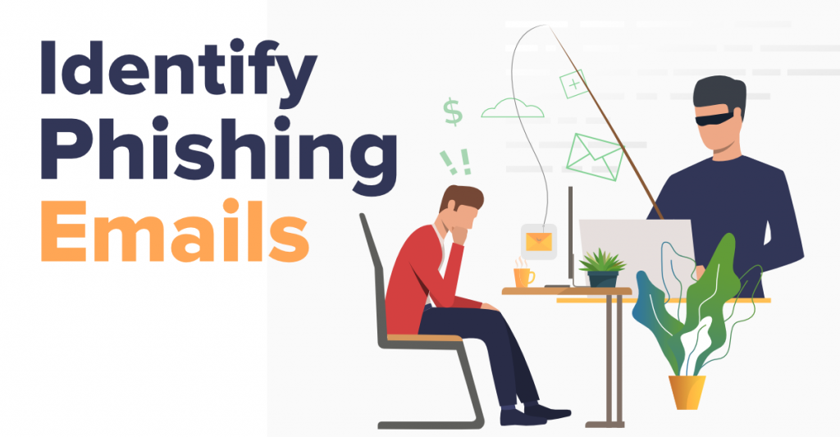
Detecting fake website
Verify Authenticity
To ensure a website is genuine, always check for secure connections marked as HTTPS. Look for SSL certificates which confirm the site's legitimacy and connection security.
URL CHECKS
To avoid phishing scams , always inspect the domain names closely, Be vigilant for typos or extra characters in URLs, as these can indicate a fraudulent site

Slide 6

QUIZZES
You receive an email asking for your login credentials:
What should you do?
a)Reply with credentials
b) Ignore & Report (Correct)
c) Click and check the link

Slide 7
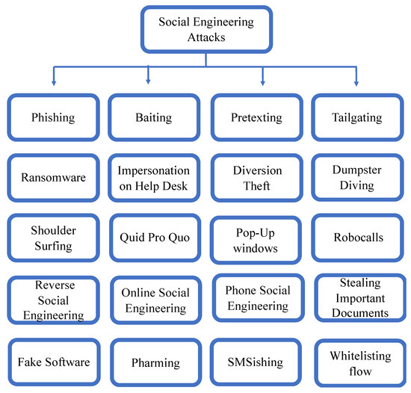
SOCIAL ENGINEERING TACTICS
Social engineering exploits human psychology. The tactics above are common methods attackers use to manipulate individuals.

Slide 8
PROTECTION BEST PRACTICES
Secure Email Habits
Always use strong, unique passwords and enable authentication for added security against unauthorized access.
Security Tools
Ensure your devices have up-to-date anti-virus software and keep your operating systems regularly updated for maximum protection.
Reporting Procedures
Understand the appropriate contacts for reporting phishing incidents and actively report any suspicious emails that you receive.

Slide 9

REAL-WORLD EXAMPLE & TIPS
Case Studies
Explore real phishing cases that compromised data security, and learn from their mistakes to bolster your defenses
Key Takeaways
Summarize essential phishing awareness points discussed, ensuring you grasp the critical information needed to protect yourself
Additional Resources
Find links to in-depth guides and articles that expand your knowledge on phishing prevention and security best practices

Slide 10
CONCLUSION
Phishing awareness training is crucial for individuals and organizations to mitigate the risks associated with increasingly sophisticated phishing attacks. By educating users on how to identify and respond to phishing attempts, organizations can significantly reduce the likelihood of successful attacks and protect themselves from financial, reputational, and operational damage. Continuous training and awareness programs are essential to stay ahead of evolving phishing tactics.

Slide 11
THANK YOU

